Slide 1

Aladdin—Make AI add in!
(An automatic model intrepretability platform)
“Do you trust me?”
“Tell her the TRUTH!”
“Let’s make some magic!”
“Genie, you’re free!”

Slide 2
WHY-0
SITUATION:
- The goal of science is to gain knowledge,
BUT many problems are solved with big datasets &
BLACK BOX machine learning models.
- Accuracy on cross validation can be very misleading.(it should not be your only metric for assessing trust.)
feels unexpectedly sick and asks, “Why do I feel so sick?”. He learns that he gets sick every time he eats those red berries. He updates his mental model and decides that the berries caused the sickness and should therefore be avoided.
“Why did my dog bite me even though it has never done so before?” “The dog was under stress and bit.”
Amazon recommend some product:
“It is based on frequently purchased product combinations”
rejects a loan application from applicants?
“…”

Slide 3
WHY-Zero
“Why did my dog bite me even though it has never done so before?” “The dog was under stress and bit.”
Amazon recommend some product:
“It is based on frequently purchased product combinations”
Rejects a loan application from applicants?
“…”
Notes:
Human desire to find meaning in the world. We want to harmonize contradictions between elements of our knowledge structures.
“Why did my dog bite me even though it has never done so before?” a human might ask. There is a contradiction between the knowledge of the dog’s past behavior and the newly made.
Another example is product recommendation. it makes sense to suggest gloves if I already have a winter hat in my shopping cart. Increasingly, Internet companies are adding explanations to their recommendations. A good example is the Amazon product recommendation, which is based on frequently purchased product combinations.
If a machine learning model rejects a loan application, this may be completely unexpected for the applicants. The explanations do not actually have to fully explain the situation, but should address a main cause.

Slide 4
Why-1: Why we should know WHY?
Knowing the ‘why’ can help you learn more about the problem, the data and the reason why a model might fail.
Provide
Allow
Change
Behavior
Non-ML Expert
Reasons,
Logic
Human-friendly
explanations
Understand in friendly way
Learn More,
Why fail
…
Improve the model
ML Expert
Notes:
The reasons provide the guidelines on how to change behavior.
Understanding the reasons and logic can provide human-friendly explanations. Human-friendly explanations allow non-experts to understand complicated algorithms.

Slide 5

WHY-2
Human curiosity and learning:
When opaque machine learning models are used in research, scientific findings remain completely HIDDEN if the model only gives predictions without explanations.
Machine learning models:
can only be DEBUGGED & AUDIT when they can be interpreted
huskies OR wolves??
The classifier learned to use SNOW as a feature
for classifying images as “wolf”….
SNOW🡪Failures
Notes:
Consider an example of a husky versus wolf classifier that misclassifies some huskies as wolves.
The classifier learned to use snow as a feature for classifying images as “wolf”, which might make sense in terms of separating wolves from huskies in the training dataset, but not in real-world use.
Using interpretable machine learning methods, you would find that the misclassification was due to the snow on the image.

Slide 6
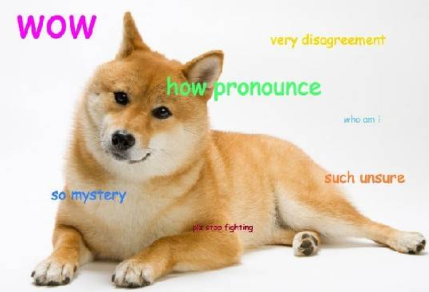


What-1
manage social interactions
vacuum cleaner:
“Doge”
human can understand the cause of a decision;
detecting bias
Increase social acceptance
Interpretability is the degree to which a human can understand the cause of a decision：
The higher the interpretability of a machine learning model, the easier it is for someone to comprehend why certain decisions or predictions have been made.

Slide 7

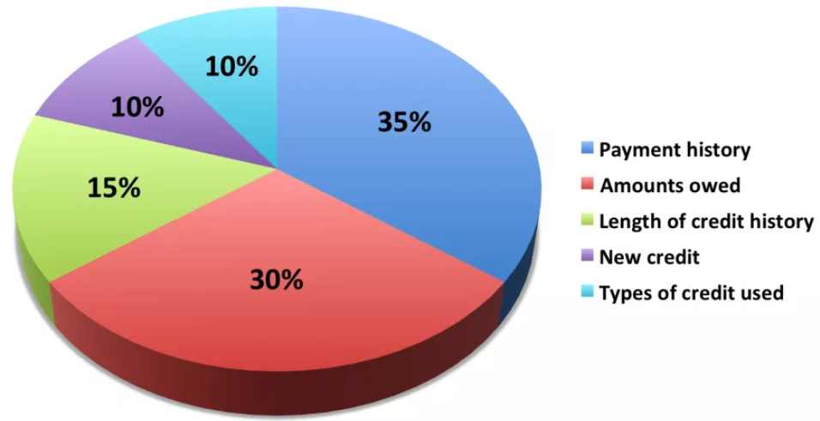
What-2
Interpretability is a useful debugging tool for detecting bias in machine learning models.
Grant loans only to people
who will eventually repay them.
Recent Negative Items on Credit Reports
Notes:
Interpretability is a useful debugging tool for detecting bias in machine learning models:
Your main goal is to grant loans only to people who will eventually repay them. It might happen that the machine learning model you have trained for automatic approval or rejection of credit applications discriminates against a minority.
This is an additional constraint that is part of your problem formulation that is not covered by the loss function the machine learning model was optimized for.

Slide 8
What-3
manage social interactions
understand the cause of a decision;
detecting bias
Increase social acceptance
Interpretability could increase social acceptance:
“when I find out that Doge has knocked over a plant while dutifully vacuuming the house”….
A machine or algorithm that explains its predictions will find more acceptance.

Slide 9
What-3
manage social interactions
understand the cause of a decision;
detecting bias
Increase social acceptance
Doge got stuck could be :
the battery was very low
that one of the wheels is not working properly
there is a bug that makes the robot go to the same spot over and over again even though there was an obstacle.
Carpet block its way🡪an even surface
…
Explanation are used to manage social interactions:
Notes:
These reasons (and a few more) caused the robot to get stuck, but it only explained that something was in the way, and that was enough for the owner to trust its behavior and get a shared meaning of that accident.
By the way, if the vacuum robot got stuck in the bathroom again. We have to remove the carpets each time before it got stuck again. As an explanation for the accident, the robot told us that it needs to be on an even surface.

Slide 10
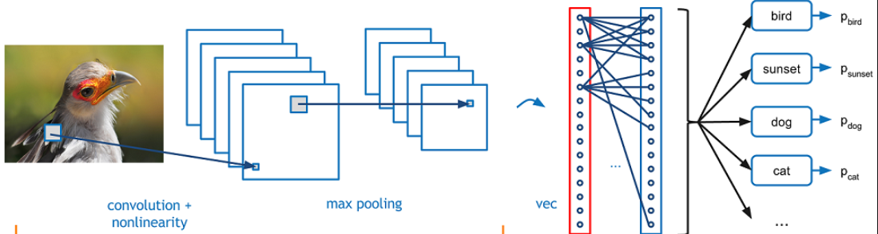
How-1
intrinsically interpretable models
Post hoc methods can also be applied to
intrinsically interpretable models.
Post hoc methods
restricting the complexity of the machine learning model
by applying methods that analyze the model after training
Each step can be evaluated
in terms of transparency
or interpretability:

Slide 11
How-2
Each step can be evaluated in terms of transparency or interpretability:
Algorithm
Transparency
Global, Holistic Model
Interpretability
Global Model Interpretability
on a Modular Level
How does the
algorithm
create the model?
How does the
trained model
make predictions?
How do parts of the model
affect predictions?
understand how the model makes decisions: based on a holistic view of its features and each of the learned components such as weights, other parameters, and structures,
Which features are important?
What kind of interactions between them take place?
For linear models:
the interpretable parts are the weights,
For trees:
it would be the splits (selected features plus cut-off points) and leaf node predictions.
Algorithm transparency only requires:
knowledge of the algorithm !
NOT the data or learned model.
Explain:
How the algorithm works:
the algorithm learns edge detectors and filters on the lowest layers
Notes:
Methods for machine learning interpretability can be classified according to various criteria.
An algorithm trains a model that produces the predictions. Each step can be evaluated in terms of transparency or interpretability.
convolutional neural networks to classify images, you can explain that the algorithm learns edge detectors and filters on the lowest layers. This is an understanding of how the algorithm works, but not for the specific model that is learned in the end, and not for how individual predictions are made.

Slide 12
How-2
Local Interpretability for a Single Prediction
Local Interpretability for a Group of Predictions
Why did the model
make a certain prediction
for an instance?
The global methods can be applied by taking the group of instances, treating them as if the group were the complete dataset；
Using the global methods with this subset.
The individual explanation methods can be used on each instance and then listed or aggregated for the entire group.
be more accurate than global explanations.

Slide 13

Evaluation
Aladdin evaluates the system qualitatively, asking users if the human-friendly explanations are understandable and make logical sense given their domain expertise.
HOW?
FOLLOW US:
https://www.linkedin.com/company/skunkworksneu/

Slide 14
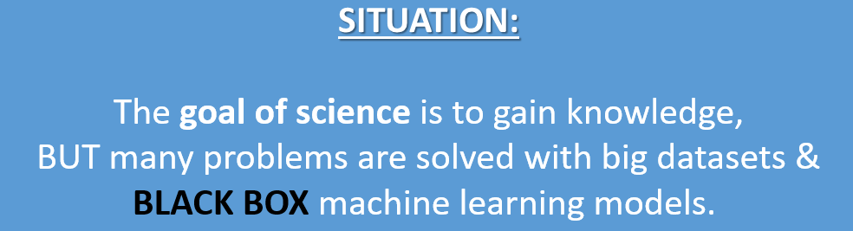
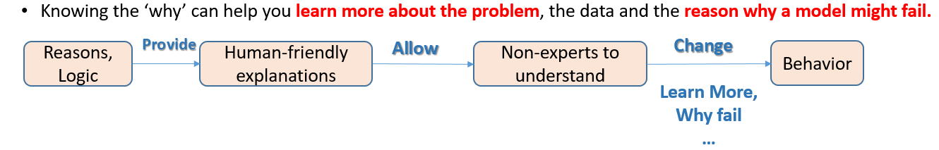

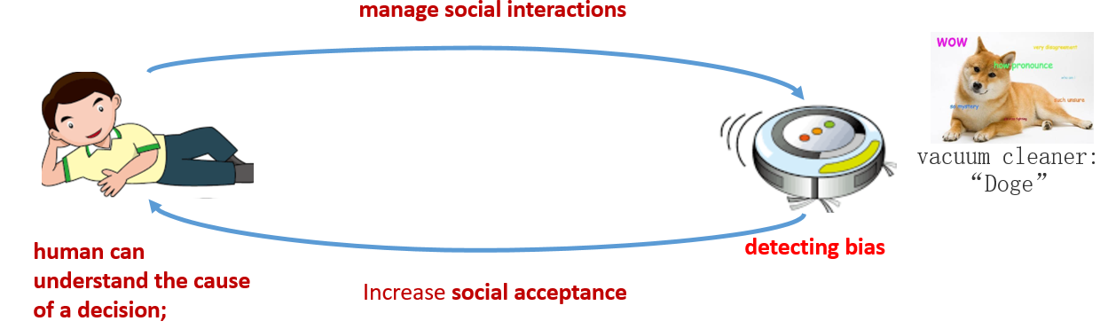
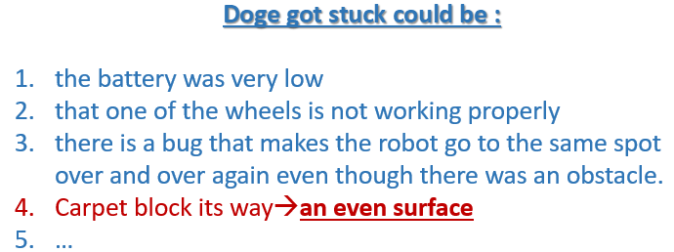

Notes:
1. Situation & WHY:
Understanding the reasons and logic can provide human-friendly explanations. Human-friendly explanations allow non-experts to understand complicated algorithms.
The reasons could provide the guidelines on how to change behavior.
2. Sometimes the Doge will get stuck due to some potential reasons.
, but it only explained that something was in the way.
As an explanation for the accident, the robot told us that it needs to be on an even surface.
If the Doge got stuck in the bathroom again. We have to remove the carpets each time before it got stuck again.
This is kind of guidance to change the behavior before it occurs again.
3. What happen after AI-Addin:
If only we get to know the real reason is, the humans can understand the cause well and manage the social interactions.

Slide 15
Project Architecture

Slide 16

Data Processing
Basic Training
Saran
Saran/MengYing
Saran
Saran
Calculate Matrix:
AUC/CM …
Calculate:
Feature importance
Select:
Plot to interpret
Input the fields
If Interpretable
Saran
Saran
Load:
Dataset
Train:
Model
-Partial Dependence Plot (PDP)
-Individual Conditional Expectation (ICE)
- *Accumulated Local Effects (ALE) Plot
Interpret
fidelity measure
If Non-Interpretable
Saran
Yang
Saran
Grace/Mengying
Ziwei
Select:
Surrogate Model
Calculate:
Feature importance
Yang
Saran
Grace/Mengying
Ziwei
Assign:
Target
Linear(LIME) Grace/Mengying
CART Decision Tree Yang
Logistic Regression Ziwei
KNN Saran
*RuleFit
*Naïve Bayes
Yang
Saran
Grace/Mengying
Ziwei
Select:
Plot to interpret
Train:
Surrogate Model
*Adversarial training
Yang
Saran
Grace/Mengying
Ziwei
Discover and remedy weaknesses.
Calculate Matrix:
AUC/CM …
Influence Analysis
Yang
Saran
Grace/Mengying
Ziwei
Compare:
With original model
Notes:
The fidelity measure (how well the interpretable model approximates the black box predictions) gives us a good idea of how reliable the interpretable model is in explaining the black box predictions in the neighborhood of the data instance of interest.
influence analysis: model becomes increasingly unstable when predicting cancer for higher ages. This means that errors in these instances can have a strong effect on the model.

Slide 17
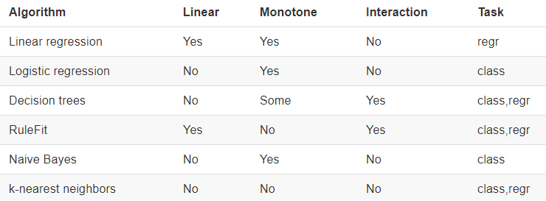
A global surrogate model is an interpretable model that is trained to approximate the predictions of a black box model.
Interpretable
Surrogate models
Black Box model...
Interpretable
e.g.: SVM
Linear(LIME) Grace/Mengying
CART Decision Tree Yang
Logistic Regression Ziwei
KNN Saran
*RuleFit
*Naïve Bayes
approximate
Model

Slide 18


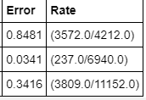
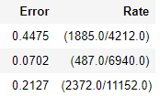
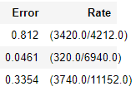
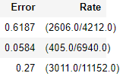
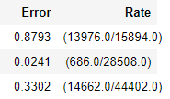
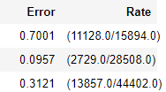
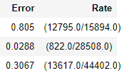
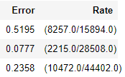
Model | AUC |  | Confusion Matrix |  | R Square
 | Without Summary | Summary Added | Without Summary | Summary Added | Without Summary | Summary Added
Baseline Model (Gradient Boosting) | 0.595 | 0.85 | threshold = 0.481817841 | threshold = 0.4515076 | 'train': 0.16798865, 'valid': 0.04741188 | NA
Logistic Regression | 0.571 | 0.791 | threshold = 0.594261 | threshold = 0.4492436 | 'train': 0.0453967, 'valid': 0.0124346 | 'train': 0.2411380, 'valid': 0.2437218
Decision Tree | NA 0.551 | NA 0.692 | threshold = 0.630645 | threshold = 0.6264891 | 'train': 0.0113891, 'valid': None | 'train': 0.01138911, 'valid': None
Linear Regression | 0.662 | 0.812 | threshold = 0.53953 | threshold = 0.4661578 | 'train': 0.2922592, 'valid': None | 'train': 0.2922592, 'valid': None
Baseline Model
BLACK BOX Model
Surrogate
#1 BEST!
Notes:
Since surrogate models alone do not gaurantee accurate transparency, they will be used along with GBM variable importance and LOCO to build a cohesive narrative about the mechansims within the GBM.
Because most currently-available explanatory techniques are approximate, it is recommended that users employ several different explanatory techniques and trust only consisent results across techniques.
AUC provides an aggregate measure of performance across all possible classification thresholds.
interpreting AUC is as the probability that the model ranks a random positive example more highly than a random negative example: A model whose predictions are 100% wrong has an AUC of 0.0; one whose predictions are 100% correct has an AUC of 1.0.

Slide 19
Interpretable Models
(Surrogate Model)

Slide 20
Linear(LIME)
Decision Tree
Logistic Regression
RuleFit
Naïve Bayes
KNN
Lasso
linear regression
Decision Tree
Logistic Regression

Slide 21
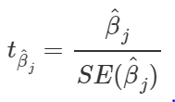
linear regression model - Interpretation
1. Interpretation of a Numerical Feature:
An increase of feature xk by one unit increases the prediction for y by βk units when all other feature values remain fixed.
2. Interpretation of a Categorical Feature:
Changing feature xk from the reference category to the other category increases the prediction for y by βk when all other features remain fixed
3. Feature Importance:
The importance of a feature, measured by:

Slide 22
Interpretation of a numerical feature (temperature):
An increase of the temperature by 1 degree Celsius, increases the predicted number of bicycles by 110.7, when all other features remain fixed.
Interpretation of a categorical feature (“weathersit”):
When it is raining, snowing or stormy, compared to good weather , the estimated number of bicycles is -1901.5 lower – (again assuming that all other features do not change. )
When the weather is misty, the predicted number of bicycles is -379.4 lower compared to good weather, given all other features remain the same.

Slide 23
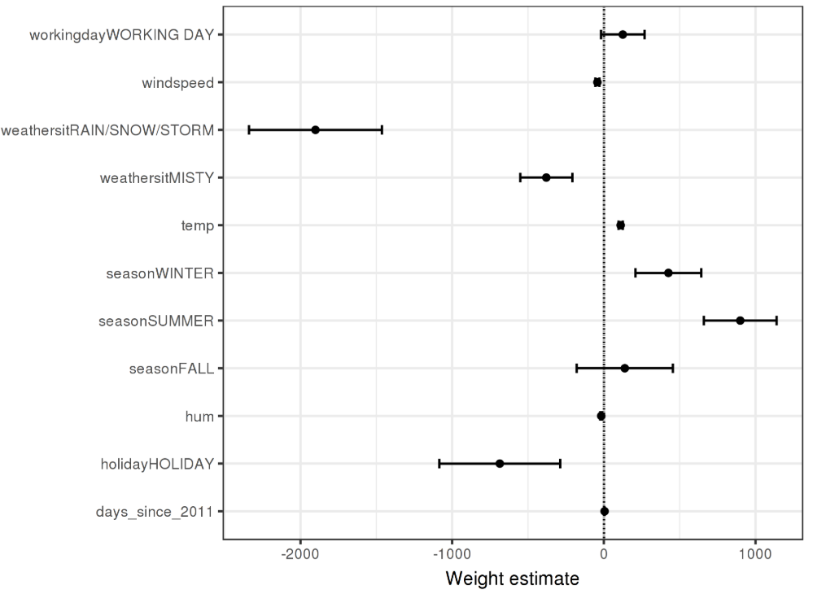
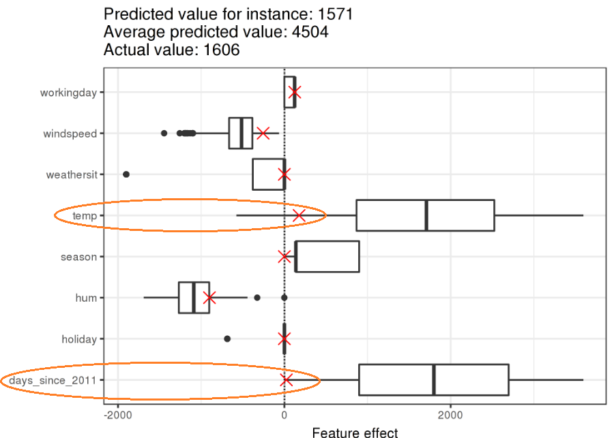
Visible plot
Weight Plot: The information of the weight table (weight and variance estimates)
Effect Plot: how much the combination of weight &
feature contributes to the predictions in your data
which is the weight per feature times the feature value of an instance:
Notes:
The effect plot reveals the reason why:
The 6-th instance has a low temperature effect: because on this day the temperature was 2 degrees, which is low compared to most other days (and remember that the weight of the temperature feature is positive).
The effect of the trend feature “days_since_2011” is small, compared to the other data instances because this instance is from early 2011 (5 days) and the trend feature also has a positive weight.

Slide 24
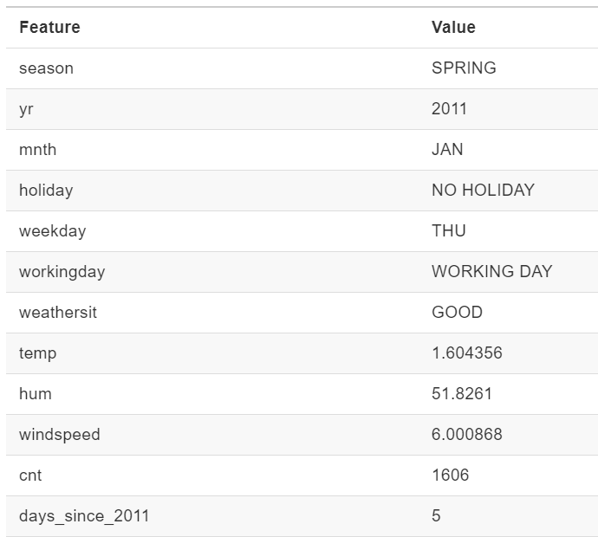
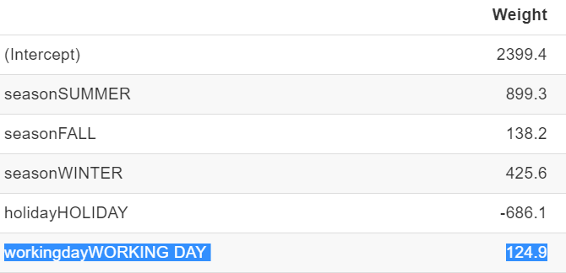
Explain Individual Predictions
only makes sense in comparison to the distribution of the effect for each feature.
*
effect
“WORKING DAY” of feature “workingday”, the effect is, 124.9.
“temperature” of 1.6 degrees Celsius, the effect is 177.6 (1.6*110.7).

Slide 25
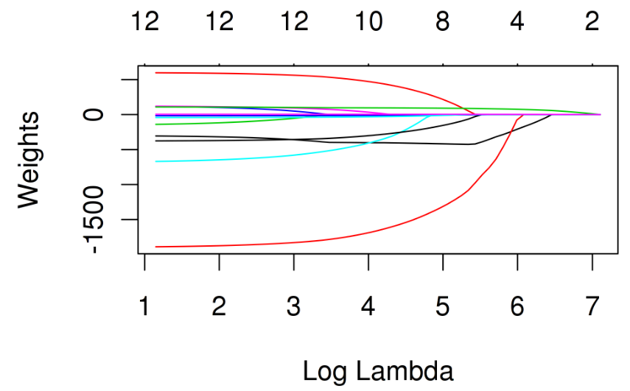
Lasso
You can also consider lambda as a parameter to control the interpretability of the model.
The larger the penalization, the fewer features are present in the model (because their weights are zero) and the better the model can be interpreted.
E.g.:
predict bicycle rentals using Lasso, Let us first set the number to 2 features:
The first two features with non-zero weights in the Lasso path are temperature (“temp”) and the time trend (“days_since_2011”).

Slide 26
Logistic Regression
Numerical feature:
Increase the value of feature xj by one unit, the estimated odds change by a factor of exp(βj)
Binary categorical feature:
Changing the feature xj from the reference category to the other category changes the estimated odds by a factor of exp(βj).

Slide 27
Decision Tree
Reach the leaf node, the node tells you the predicted outcome. All the edges are connected by ‘AND’.
Template:
If feature x is [smaller/bigger] than threshold c AND … then the predicted outcome is the mean value of y of the instances in that node.

Slide 28
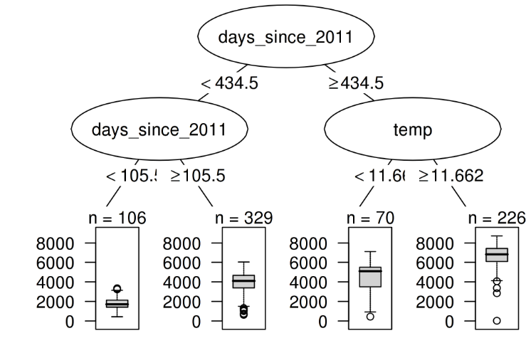
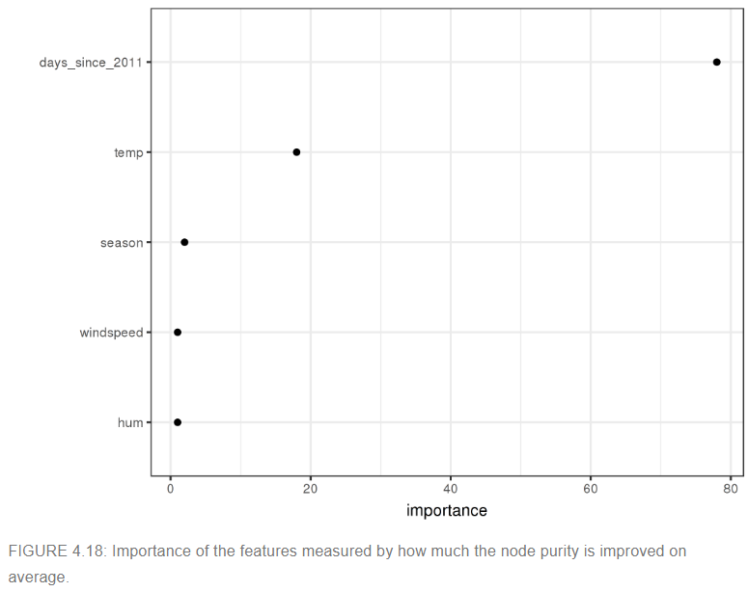
The feature importance tells us how much a feature helped to improve the purity of all nodes.
shows that the time trend is far more important than temperature.

Slide 29
K-Nearest Neighbors
an instance-based learning algorithm.
if you have few features or a way to reduce your instance to the most important features, presenting the k-nearest neighbors can give you good explanations.

Slide 30
Model-Agnostic Methods

Slide 31
Feature Importance
A feature is “important” if shuffling its values increases the model error, (because in this case the model relied on the feature for the prediction.)

Slide 32
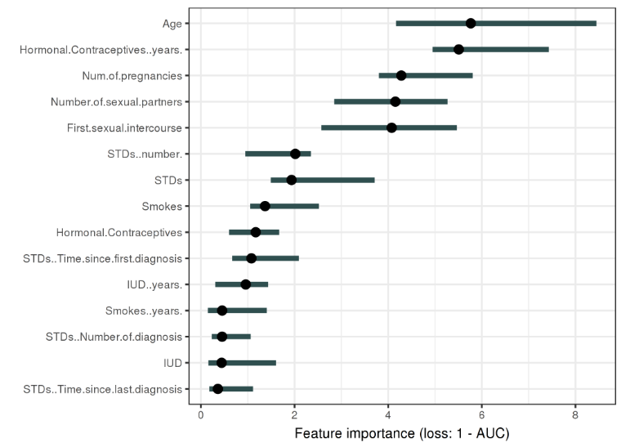
The most important feature was Age:
The feature with the highest importance was Age associated with an error increase of 5.76 after permutation.
The least important was STD..Time.Since.last.diagnosis.

Slide 33
Partial Dependence Plot (PDP)
Can show whether the relationship between the target and a feature is linear, monotonous or more complex?
For classification:
Where the machine learning model outputs probabilities, the PDP displays the probability for a certain class given different values for feature(s) in S.
Multiple classes is to draw one line or plot per class.

Slide 34
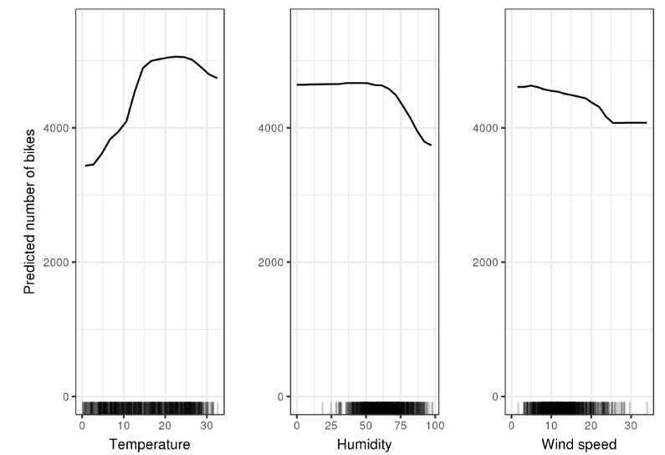
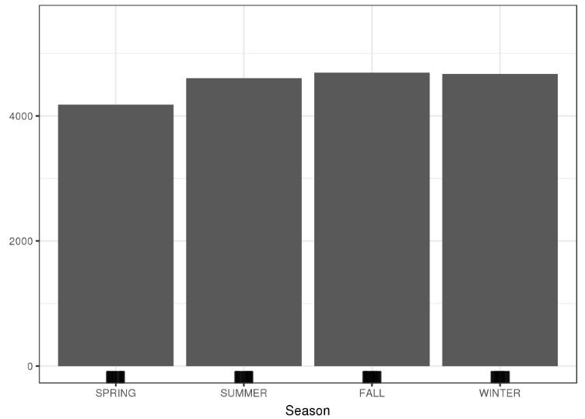
The largest differences can be seen in the temperature.
PDPs for the bike count prediction model and the seasonss. Unexpectedly all seasons show the same effect, only for spring the model predicts less bicycle rentals.

Slide 35
Individual Conditional Expectation (ICE)
display one line per instance that shows how the instance’s prediction changes when a feature changes.
Interpretation:
The feature with the highest importance was XXX associated with an error increase of XXX after permutation.

Slide 36
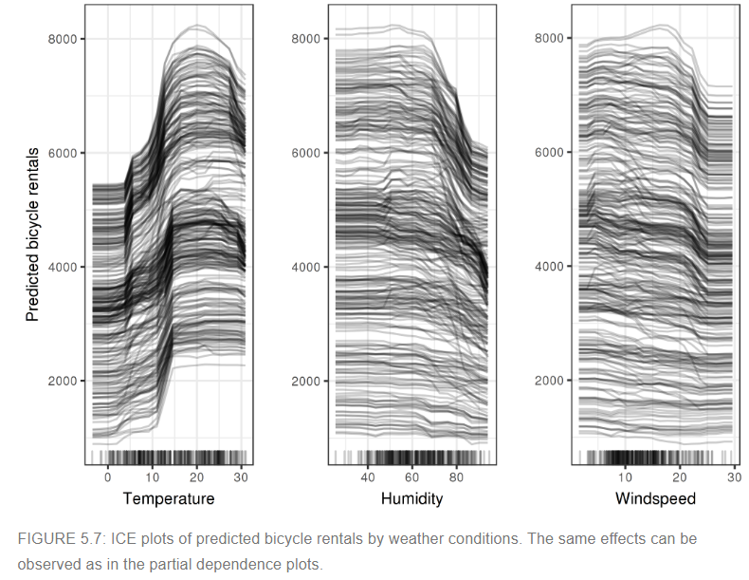
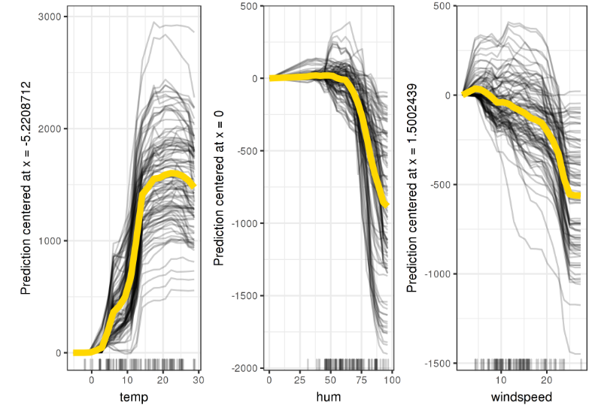
Centered ICE Plot(c-ICE):

Slide 37
Accumulated Local Effects (ALE) Plot
Share the same goal with PDP: Both describe how a feature affects the prediction on average.
Solve: for the interaction of two features, differences in predictions instead of averages.
(If two features do not interact, the plot shows nothing.)
Faster and unbiased alternative to partial dependence plots (PDPs).

Slide 38
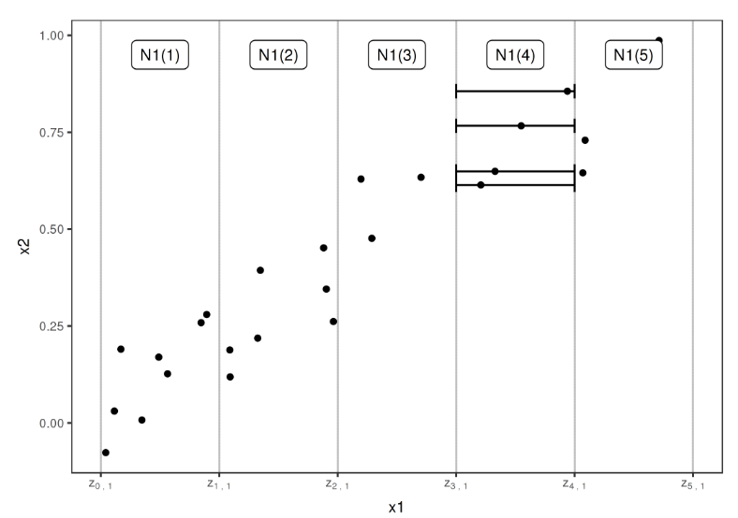
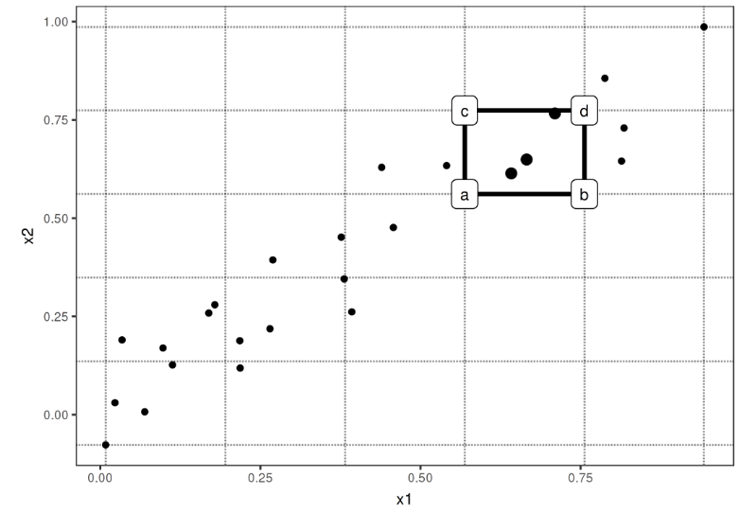
for the interaction of two features
calculate the difference in the prediction when we:
Replace the feature with the upper and lower limit of the interval (horizontal lines).
the 2nd-order difference is (d - c) - (b - a):
2nd-order difference in each cell is accumulated over the grid and centered

Slide 39
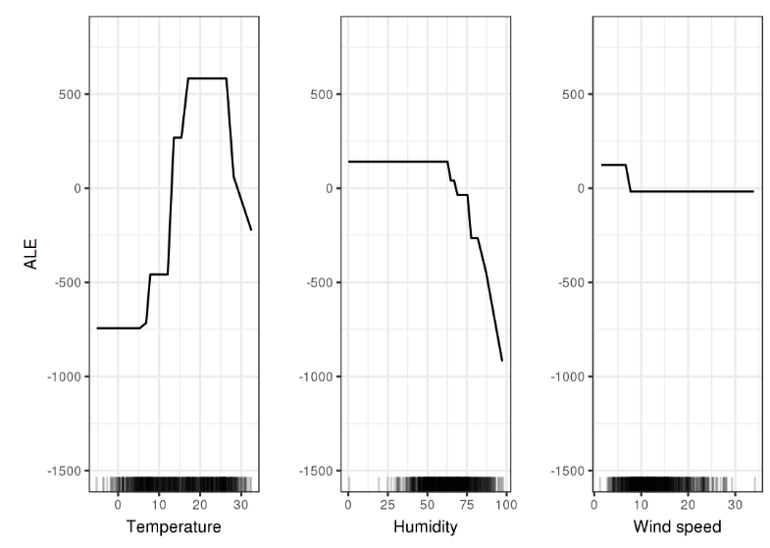
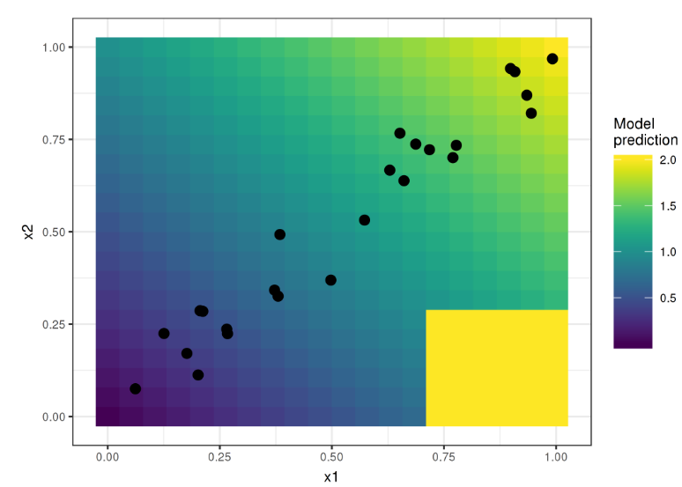
The temperature has a strong effect on the prediction:
The average prediction rises with increasing temperature, but falls again above 25 degrees Celsius.
Humidity has a negative effect: When above 60%, the higher the relative humidity, the lower the prediction.
The wind speed does not affect the predictions much.
Two features and the predicted outcome:
The model predicts the sum of the two features (shaded background), with the exception that if x1 is greater than 0.7 and x2 less than 0.3, the model always predicts 2.
(This area is far from the distribution of data (point cloud) and does not affect the performance of the model and also should not affect its interpretation.)

Slide 40
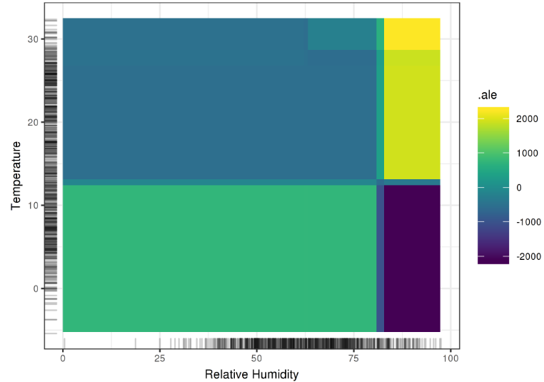
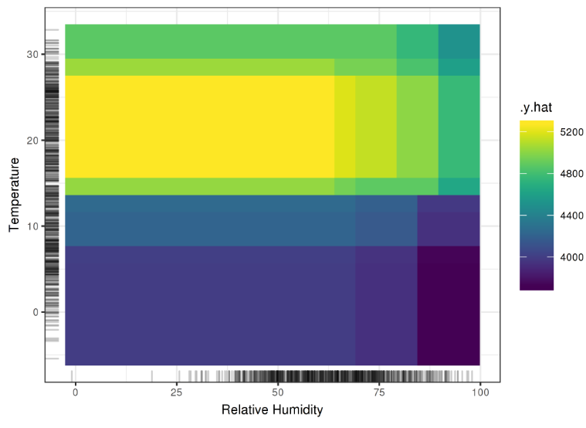
Hot and humid weather: increases the prediction.
In cold and humid weather: an additional negative effect on the number of predicted bikes is shown.
The plot combines the main effect of each of the features and their interaction effect, as opposed to the 2D-ALE plot which only shows the interaction.

Slide 41
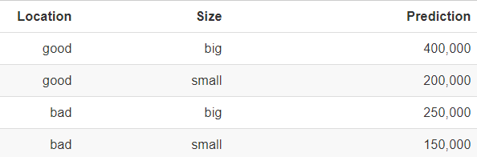
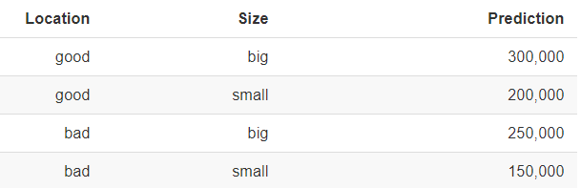
Overall Interaction(Feature Interaction)
The interaction between two features is the change in the prediction that occurs by varying the features after considering the individual feature effects.
“H-statistic”: to estimate the interaction strength is to measure how much of the variation of the prediction depends on the interaction of the features.
With interaction
No interaction
decompose the prediction table into the following parts:
A constant term (150,000)
An effect for the size feature (+100,000 if big, +0 if small)
An effect for the location (+50,000 if good, +0 if bad).
For this table we need an additional term for the interaction:
- 100,000: if the house is big AND in a good location. (This is an interaction between size and location, because in this case the difference in prediction between a big and a small house depends on the location.)

Slide 42
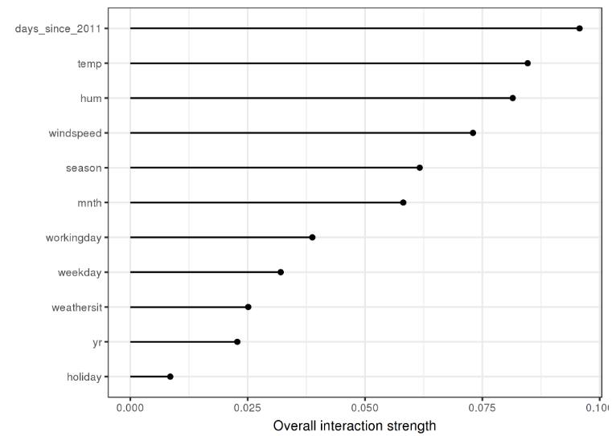
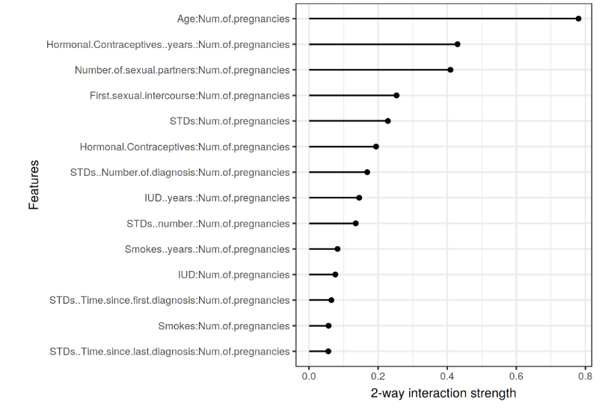
Model: SVM
The interaction strength (H-statistic) for each feature with all other features for a support vector machine predicting bicycle rentals.
Overall, the interaction effects between the features are very weak (below 10% of variance explained per feature).
The 2-way interaction strengths (H-statistic) between number of pregnancies and each other feature.
There is a strong interaction between the number of pregnancies and the age.

Slide 43
Local Surrogate (LIME)
interpretable models that are used to explain individual predictions of black box machine
Goal: to understand why the machine learning model made a certain prediction.
Generates a new dataset consisting of permuted samples and the corresponding predictions of the black box model.

Slide 44
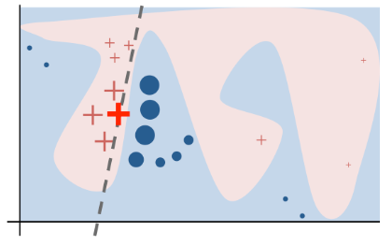
E.g.: example:
https://homes.cs.washington.edu/~marcotcr/blog/lime/
S1: blue/pink background: The original model's decision function is represented by the blue/pink background, and is clearly nonlinear.
S2: The bright red cross: the instance being explained (let's call it X).
S3: Sample perturbed instances around X.
S4: Weight them according to their proximity to X (weight here is represented by size).
S5: Get original model's prediction on these perturbed instances,
S6: Learn a linear model (dashed line) that approximates the model well in the vicinity of X. Note that the explanation in this case is not faithful globally, but it is faithful locally around X.

Slide 45
Shapley Values
tells us how to fairly distribute the “payout” among the features.
It is the average marginal contribution of a feature value across all possible coalitions.
A solution for computing feature contributions for single predictions for any machine learning model.
Interpretation:
The value of the j-th feature contributed ϕj to the prediction of this particular instance compared to the average prediction for the dataset.

Slide 46
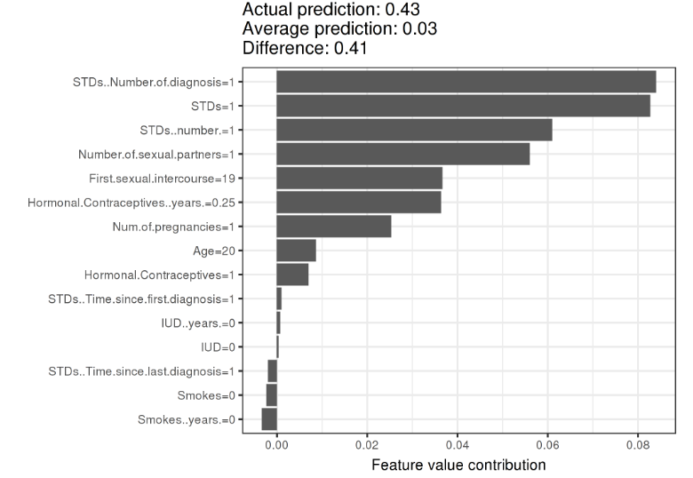
With a prediction of 0.43, this woman’s cancer probability is 0.41 above the average prediction of 0.03.
The number of diagnosed STDs increased the probability the most.
The sum of contributions yields the difference between actual and average prediction (0.41).

Slide 47
FOR RISE 2019

Slide 48
Scenario & Why ‘Interpretability’?
 | Fields | Cases | Just know what is predicted…(Previously) | Know why the prediction was made! | Manipulate system!
High- Risk | Medical/ Healthcare | Drug effect | How effective some drug will be for a patient... | Reveals the reasons why the drug would or would not work in specific cases. | Help the experts to design better therapeutic drugs in the future
 |  | Disease prediction | Flu prediction by multiple mixed symptoms... | Highlight which symptoms in the patient’s history led to the prediction. | Doctors can make an informed decision about the model’s prediction.
 |  | Cancer Classification | Classifying benign and malignant cancer cells... | Lead to the feature supports predicted label, and the red bars contradict it. | Understand what made model misclassify labels and tune.
 | Finance | Credit card/Loan Fraud | Some unexpected rejection came from systems for the applicants... | Figure out the reason codes contributing to the high probability of default. | Improve the model to prevent someone to deceive a system.
Low- Risk | E-commercial | Products recommender system | Products recommender system... | Explore the related features cause this recommendation. | Optimize the recommendation system to increase the accuracy.
 | Others... | Spam Email recognition | Remove the email due to the possibility of ‘spam’... | Generate the high-frequent words/features cause this recognition | The email sender please avoid these words if want to be received by your potential customers.
...
Notes:
If a machine learning model rejects a loan application, this may be completely unexpected for the applicants. The explanations do not actually have to fully explain the situation, but should address a main cause.

Slide 49
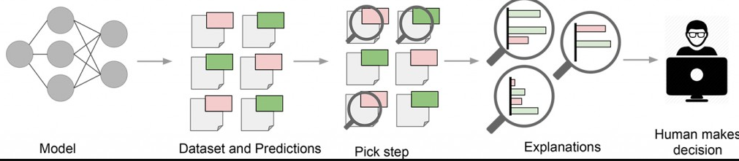
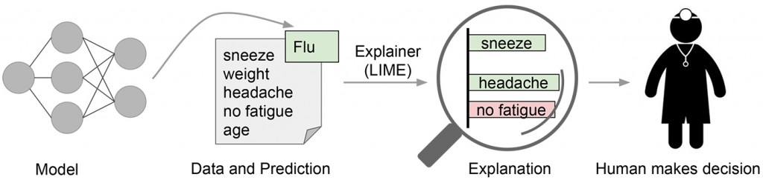
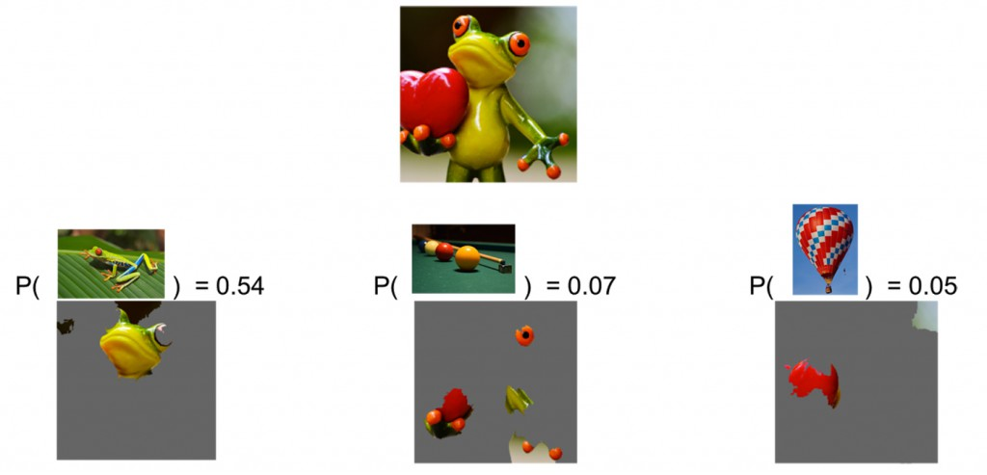
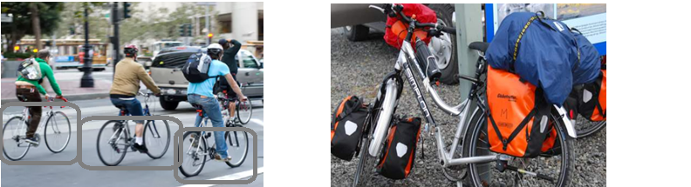
Figure 1:
Common
Figure 2:
Medical Case
Future work!
Figure 3.1:
Image Case
(LIME-
Local Interpretable Model-Agnostic Explanations)
Notes:
Figure 0: Explaining individual predictions. A model predicts that a patient has the flu, and LIME highlights which symptoms in the patient’s history led to the prediction. Sneeze and headache are portrayed as contributing to the “flu” prediction, while “no fatigue” is evidence against it. With these, a doctor can make an informed decision about the model’s prediction.

Slide 50
S1:
Data Processing
S2:
Basic Training
Saran
Saran/MengYing
Saran
Saran
Calculate Matrix:
AUC/CM …
Calculate:
Feature importance
Select:
Plot to interpret
Input the fields
If Interpretable
Saran
Saran
Load:
Dataset
Train:
Model
-Partial Dependence Plot (PDP)
-Individual Conditional Expectation (ICE)
- *Accumulated Local Effects (ALE) Plot
S3: Interpret
fidelity measure
If Non-Interpretable
Saran
Yang
Saran
Grace/Mengying
Ziwei
Select:
Surrogate Model
Calculate:
Feature importance
Yang
Saran
Grace/Mengying
Ziwei
Assign:
Target
Linear(LIME) Grace/Mengying
CART Decision Tree Yang
Logistic Regression Ziwei
KNN Saran
*RuleFit
*Naïve Bayes
Yang
Saran
Grace/Mengying
Ziwei
Select:
Plot to interpret
Train:
Surrogate Model
*Adversarial training
Yang
Saran
Grace/Mengying
Ziwei
Discover and remedy weaknesses.
Calculate Matrix:
AUC/CM …
Influence Analysis
Yang
Saran
Grace/Mengying
Ziwei
Compare:
With original model
Notes:
The fidelity measure (how well the interpretable model approximates the black box predictions) gives us a good idea of how reliable the interpretable model is in explaining the black box predictions in the neighborhood of the data instance of interest.
influence analysis: model becomes increasingly unstable when predicting cancer for higher ages. This means that errors in these instances can have a strong effect on the model.

Slide 51
A global surrogate model is an interpretable model that is trained to approximate the predictions of a black box model.
Interpretable
Surrogate models
Black Box model...
Interpretable
e.g.: SVM
Linear(LIME) Grace/Mengying
CART Decision Tree Yang
Logistic Regression Ziwei
KNN Saran
*RuleFit
*Naïve Bayes
approximate
Model

Slide 52
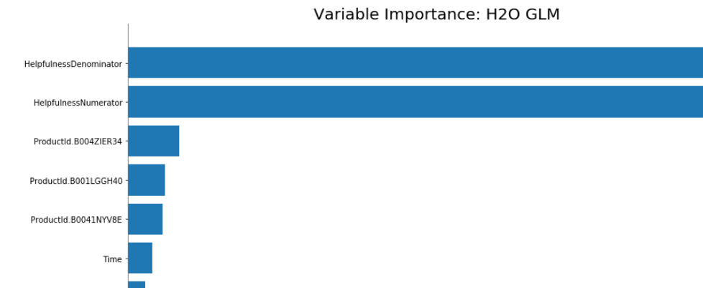
Partial Dependence Plot (PDP)
Can show whether the relationship between the target and a feature is linear, monotonous or more complex?
For classification:
Where the machine learning model outputs probabilities, the PDP displays the probability for a certain class given different values for feature(s) in S.
Multiple classes is to draw one line or plot per class.

Slide 53
Plot: Individual Conditional Expectation (ICE)
Display one line per instance that shows:
how the instance’s prediction changes when a feature changes.
Interpretation:
The feature with the highest importance was XXX associated with an error increase of XXX after permutation.

Slide 54
Model | AUC |  | Confusion Matrix |  | R Square
 | Without Summary | Summary Added | Without Summary | Summary Added | Without Summary | Summary Added
Baseline Model (Gradient Boosting) | 0.595 | 0.85 | threshold = 0.481817841 | threshold = 0.4515076 | 'train': 0.16798865, 'valid': 0.04741188 | NA
Logistic Regression | 0.571 | 0.791 | threshold = 0.594261 | threshold = 0.4492436 | 'train': 0.0453967, 'valid': 0.0124346 | 'train': 0.2411380, 'valid': 0.2437218
Decision Tree | NA 0.551 | NA 0.692 | threshold = 0.630645 | threshold = 0.6264891 | 'train': 0.0113891, 'valid': None | 'train': 0.01138911, 'valid': None
Linear Regression | 0.662 | 0.812 | threshold = 0.53953 | threshold = 0.4661578 | 'train': 0.2922592, 'valid': None | 'train': 0.2922592, 'valid': None
Baseline Model
BLACK BOX Model
Surrogate
#1 BEST!
Notes:
Since surrogate models alone do not gaurantee accurate transparency, they will be used along with GBM variable importance and LOCO to build a cohesive narrative about the mechansims within the GBM.
Because most currently-available explanatory techniques are approximate, it is recommended that users employ several different explanatory techniques and trust only consistent results across techniques.
AUC provides an aggregate measure of performance across all possible classification thresholds.
interpreting AUC is as the probability that the model ranks a random positive example more highly than a random negative example: A model whose predictions are 100% wrong has an AUC of 0.0; one whose predictions are 100% correct has an AUC of 1.0.

Slide 55
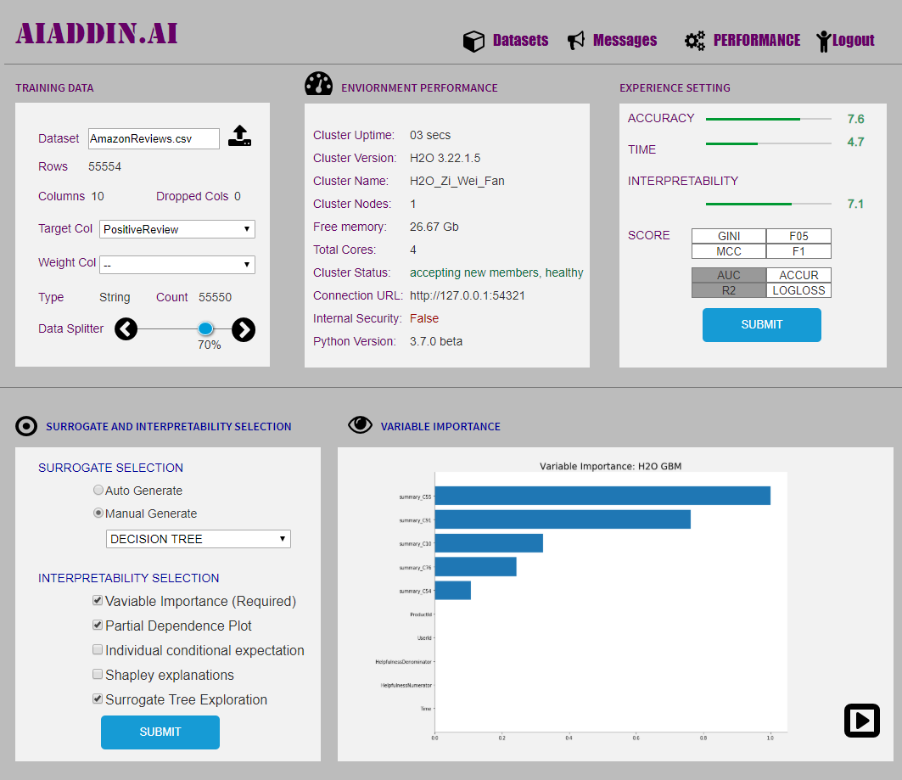

Slide 56
